Slide 1

Border Gateway Protocol
COSC 650 - Fall 2014

Slide 2
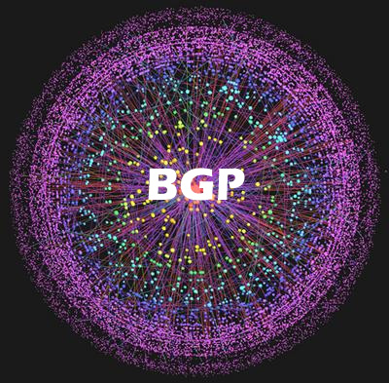
Dr. Alexander L. Wijesinha
Amir Hematian
Ibtihaj Alanazi
Kevin Kuo
Logan Bair
Mary Snyder

Slide 3
BGP – What is it?
BGP a routing protocol that share information among Gateway hosts in the network of autonomous system.
BGP is also called as path vector protocol and distance vector routing protocol.
BGP is using Transmission control protocol (TCP) to create a communication between hosts.

Slide 4
Border Gateway Protocol (BGP)
Purpose: To exchange network reachability information with other BGP systems
BGP a routing protocol that share information among Gateway hosts in the network of autonomous system.
BGP is also called as path vector protocol and distance vector routing protocol.
BGP is using Transmission control protocol (TCP) to create a communication between hosts.

Slide 5
B G P B G P
BGP send the information of updated router table only when one host point out the change.
BGP only sent change part of the routing table. BGP-4 is the latest version which facilitates the administrators to configure the cost matric according to organization policy statement.
BGP-4. Anti-loop mechanism is the critical aspect of BGP. Any routes that exist in the AS path will not be import by any router.

Slide 6
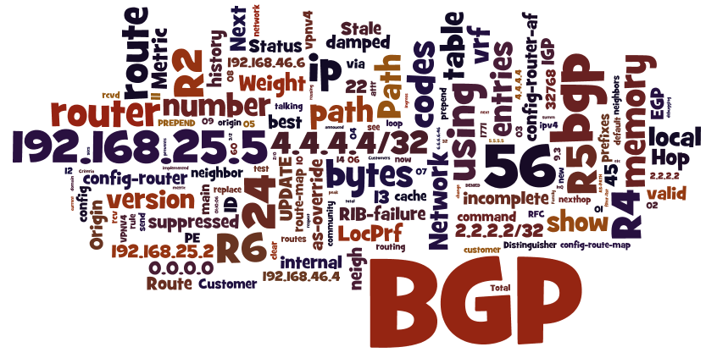

Slide 7
Popularity and effects of BGP in information technology applications
(BGP) is very popular among networks. Internet Service Provider (ISP) use BGP to create routing between different hosts.
BGP is internally used by many large private IP networks.
BGP join number of OSPF (Open shortest path first) networks.
BGP is also important in multi homing networks.

Slide 8
Advantages and Disadvantages of BGP
BGP only has one active route for a prefix at a time but the IGP may use multiple paths to get to the next-hop
BGP will make sure that the data is always sent to a machine nearer to the end point than itself that the decision process between multiple routes does not cause loops.
BGP block or redirect the traffic of your own IPs Move a machine to another geographical location connected traffic always preferred to a gateway

Slide 9
The disadvantages of BGP
Poor interaction during high load.
BGP has been found to be vulnerable to attacks and misconfigurations.
Congestion control on a routing protocol.

Slide 10
Definition of Frequentlty used terms
Exterior Gateway Protocol (EGP)
Autonomous System
Multiprotocol BGP (MBGP)
NLRI (Network Layer reachable information)
BGP Identifier

Slide 11

EBGP (External BGP)
IBGP (Internal BGP)
BGP Speaker
IGP (Interior Gateway Protocol)
Route
RIB (Routing Information Base)

Slide 12
Reasons for implementation
The primary function of a BGP speaking system is to exchange network reachability information with other BGP systems.
(Seqence of Steps for BGP)
Best Path Selection Algorithm

Slide 13
Advantages of Best Path Selection Algorithm
The proposed extension to the BGP route selection rules avoids unnecessary best-path transitions between external paths under certain conditions. Clearly, the extension would help reduce routing and forwarding changes in a network, thus helping the overall network stability

Slide 14
Implementation Of Standard
Message Format
Path Attributes
Error Handling
Timers
Security

Slide 15
HArdware and software requirements for bgp
BGP is a layer 4 protocol which comes before TCP.
It supports Classless Inter-Domain Routing and use of route aggregation to decrease the size of routings. Routers which are usually installed for small office are not capable for running BGP.
In big organizations, which have big commercial routers also need some specific executable image that contained BGP.

Slide 16
Vulnerabilities of BGP
The risks in BGP arise from three fundamental vulnerabilities:
BGP has no internal mechanism.
No mechanism has been specified within BGP to validate the authority of an AS to announce NLRI information.
No mechanism has been specified within BGP to ensure the authenticity of the path attributes announced by an AS.

Slide 17


Slide 18
References
[1] D.G.Andersen, N.Feamster, S.Bauer and H.Balakrishnan, Topology inference from BGP routing dynamics, Internet Measurement Workshop 2002, 2002.
[2] G.Huston, Analyzing the Internet’s BGP routing table, The Internet Protocol Journal, 4(1), March 2001.
[3] G.Huston, BGP routing table statistics, http://www.telstra.net/ops/bgp/
[4] G.Huston, BGP Update Presented on the routing area meeting at 54th IETF, July 2002.
[5] G. Huston, Commentary on inter-domain routing in the Internet, Internet RFC 3221.
[6]. Chen, E., Y. Rekhter, “Outbound Route Filtering apability for BGP-4”, Internet
Draft: http://www.ietf.org/internet-drafts/draft-ietf-idr-route-filter-16.txt
[7]. Christian, B., and T. Tauber, “BGP Security Requirements”, draft-ietf-rpsecbgpsecrec-07, Feb. 13, 2007.

